Slide 1
Microservices With Spring Boot
Notes:
Add instructor notes here.

Slide 2
Objectives : Microservice with Spring Boot
Section -1- Introduction
What is Spring Boot ?
Why using Spring Boot ?
Keys features.
Section-2- Spring Boot setup
Setup development environment.
Create a project using Spring Initializer.
Setup and run Spring boot App.
Create a Rest Controller with

Slide 3
Objectives : Microservice with Spring Boot
Section – 3 – Lab(Customer Microservice)
Create Customer
Get Customer
Get All Customer
Update Customer
Delete Customer

Slide 4
Section -1 Introduction Spring Boot

Slide 5
What is Spring Boot ?
Single point of focus (as opposed to large collection of spring-* projects).
A tool for getting started very quickly with Spring.
Common non-functional requirements for a "real" application.
Exposes a lot of useful features by default.
Gets out of the way quickly if you want to change defaults.

Slide 6
Why Using Spring Boot ?
Convention over configuration
Easy and quickly to create stand alone applications.
Less Configuration
Running as Microservice.
More..
Spring Data JPA
Spring Security
Testing
Spring Cloud

Slide 7
Key Features
Standalone Spring applications.
No Code generation/ No XML config.
Automatic configuration.
Stater dependencies.
Embedded Tomcat or jetty.
Production Reddy environment.
Support for Profiles.
Support for cloud native development.

Slide 8
Section -2 Spring Boot Configuration
Create a project using Spring Initializer.
Setup and run Spring boot App.
Create a Rest Controller with

Slide 9
Spring Initializer.
Go to https://start.spring.io/
Group: com.capgemini.training
Artifacts : customer
Selected Dependencies : Web, DevTools
Click on generate the project.
Unzip the generated project.

Slide 10
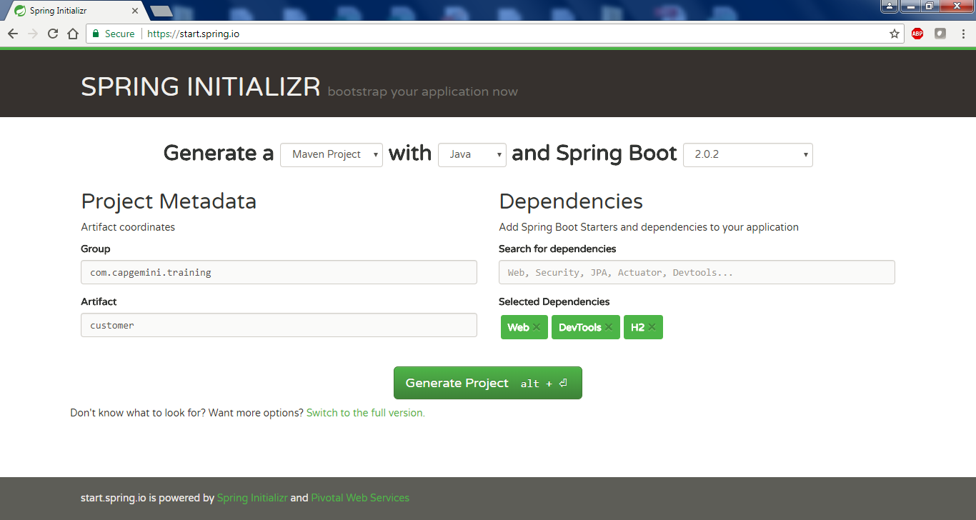
Spring Initializer continue..

Slide 11
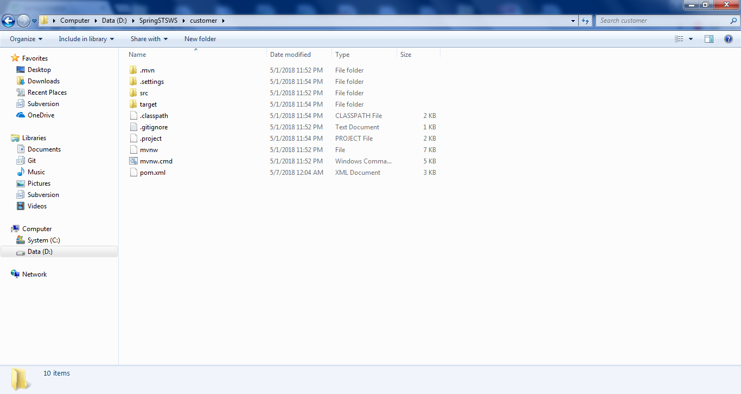
Spring Initializer continue..

Slide 12
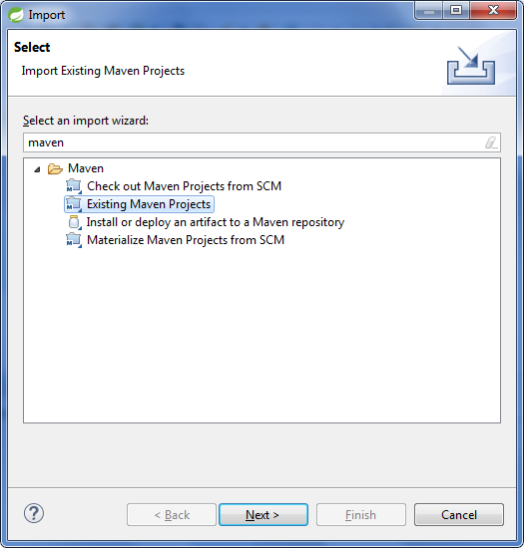
Spring Initializer Importing the project

Slide 13
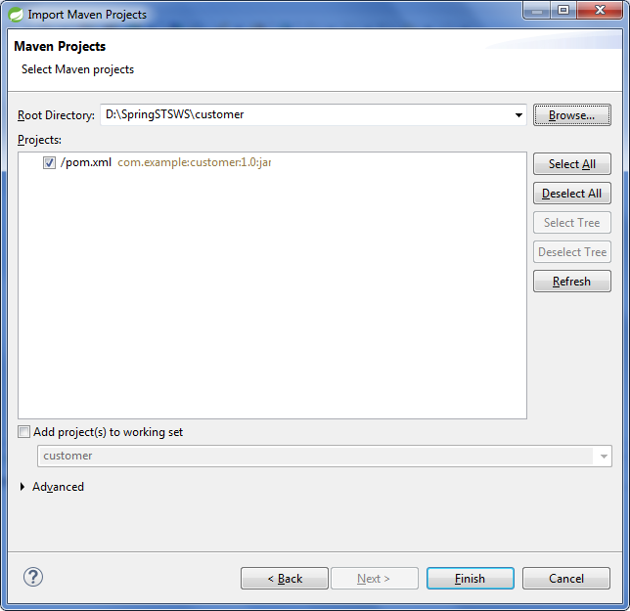
Spring Initializer Importing the project continue..

Slide 14
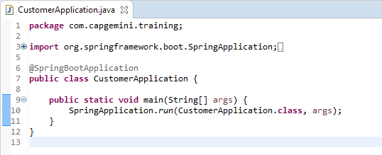
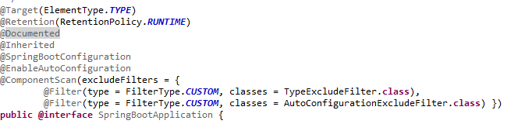
Spring Boot : @SpringBootApplication
The main class should annotated with @SpringBootApplication Which is actually inherit the three annotation
@SpringBootConfiguration
@EnableAutoConfiguration
@ComponentScan

Slide 15
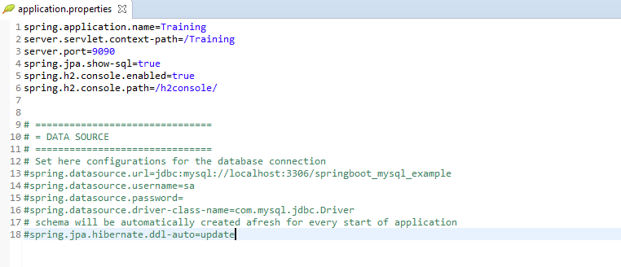
Spring boot Application.properties

Slide 16
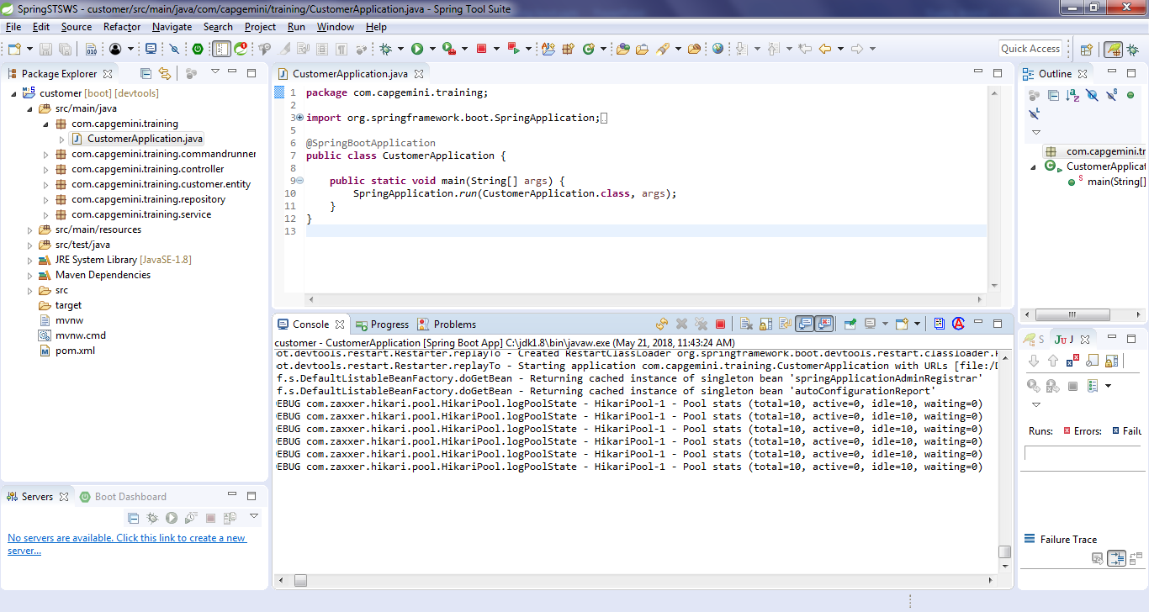
Running Spring Boot project
Right click on CustomerApplication class and select Run As SpringBoot App.

Slide 17
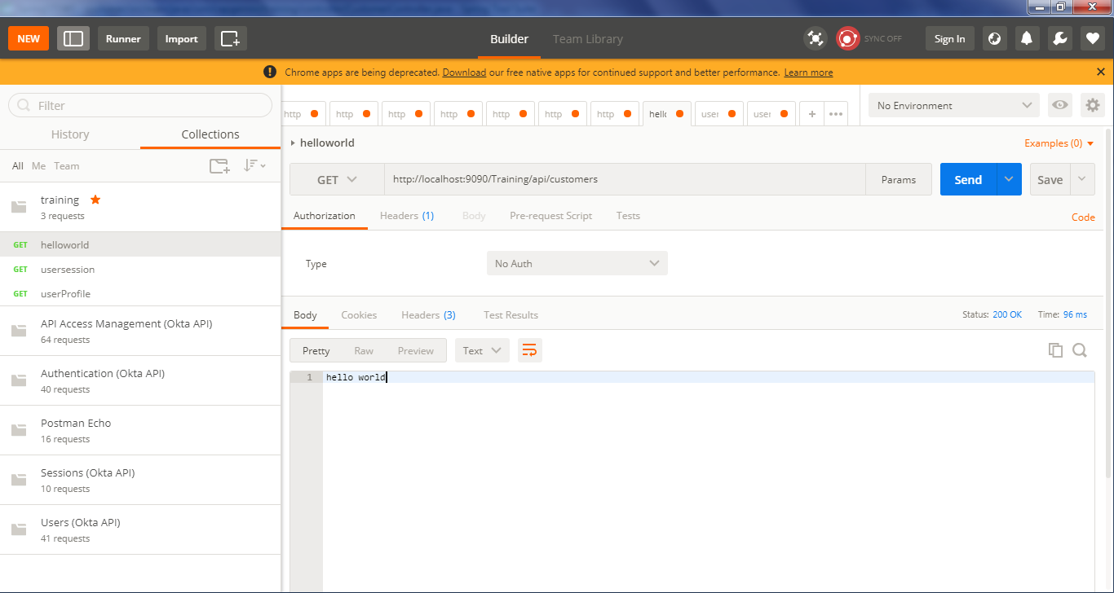
Postman : testing hello world (http://localhost:8080/customers)

Slide 18
Section -3 : – Lab(Customer Microservice)
Create Customer
Get Customer
Get All Customer
Update Customer
Delete Customer

Slide 19
Project Package Setup : Customer
Package Name | Descriptions
com.capgemini.training | This package contains the class which is used to start the Spring boot application and annotated with @SpringBootApplication
com.capgemini.training.commandrunner | Contains all the class which is used to call the functionality on the application start up and should implements CommandLineRunner.
com.capgemini.training.controller | Contains the controller classes and must be annotated with @RestController
com.capgemini.training.customer.entity | Contains all the entity classes and annotated with @Entity. These classed are used to have ORM mapping.
com.capgemini.training.repository | Contains all the repository classes and annotated with @Repository. These classed are used to perform the DB operations.
com.capgemini.training.service | Contains all the service classes and annotated with @Service annotation.

Slide 20
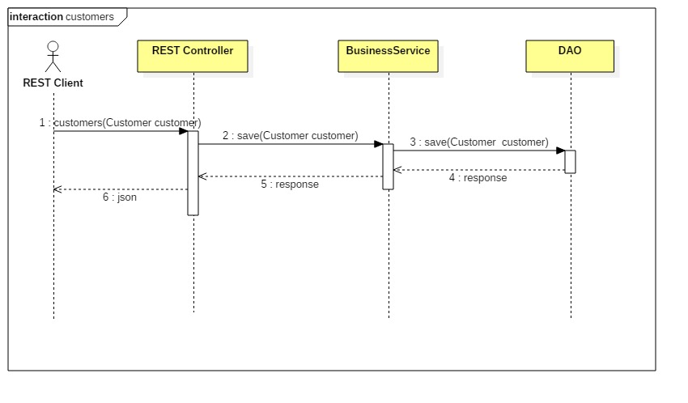
Customer Microservice: Create Customer HTTP Verb : POST

Slide 21



Customer Microservice: Create Customer
Controller
Service
DAO

Slide 22
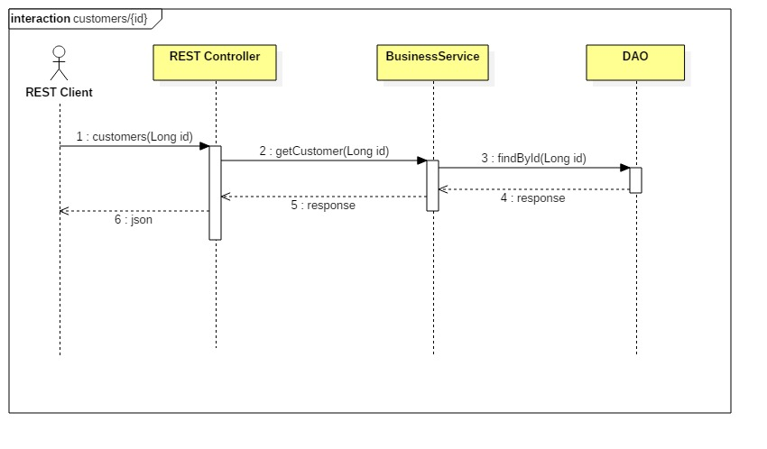
Customer Microservice: Get Customer HTTP Verb : GET

Slide 23


Customer Microservice: Get Customer
Controller
Service
DAO

Slide 24
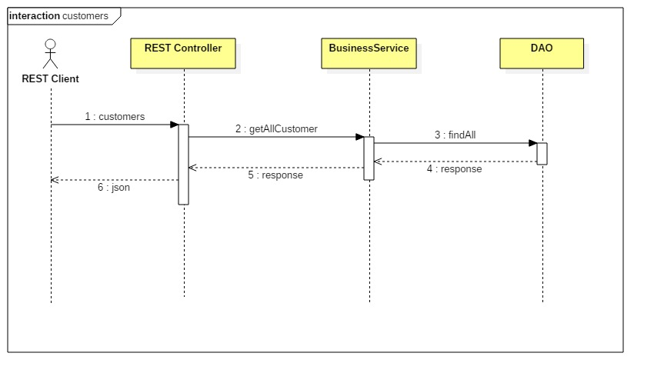
Customer Microservice: Get All Customer HTTP Verb : GET

Slide 25

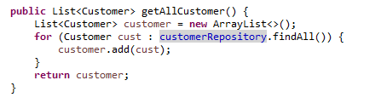
Customer Microservice: get All Customers
Controller
Service
DAO

Slide 26

Customer Microservice: update Customer HTTP Verb : PUT

Slide 27


Customer Microservice: update Customer
Controller
Service
DAO

Slide 28
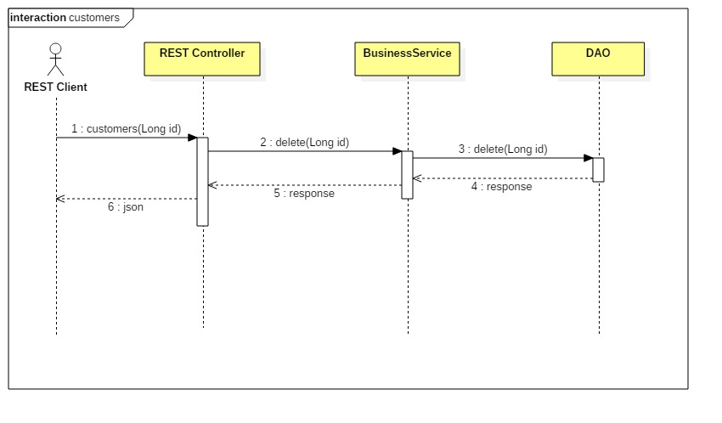
Customer Microservice: delete Customer HTTP Verb : DELETE

Slide 29
Q & A

